Slide 1
PLANT MONITORING SYSTEM
DOKUZ EYLUL UNIVERSITY
PREPARED BY
EFE ÖZDEMİR – ALPEREN KELEŞ
IZMIR 2025

Slide 2
CONTENT
INTRODUCTION
SYSTEM OVERVIEW
FEATURES
HOW IT WORKS
TECHNICAL DETAILS
RESULTS
BENEFITS
CONCLUSION

Slide 3
INTRODUCTION
Problem: Maintaining optimal conditions for plant growth is challenging for many plant enthusiasts.
Solution: A smart monitoring system that provides real-time insights into environmental conditions, helping users grow healthier plants.

Slide 4
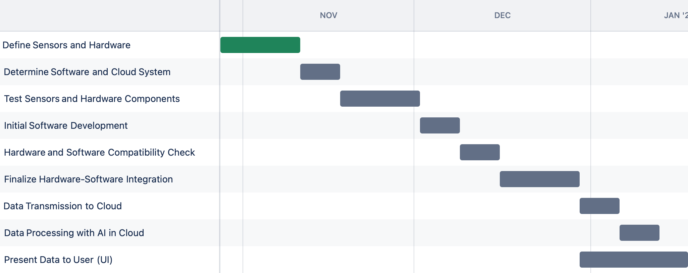
INTRODUCTION

Slide 5
SYSTEM OVERVIEW
ESP32 Microcontroller: The brain of the system.
Sensors:
10mm LDR: Measures light intensity.
FC-28 Soil Moisture Sensor: Monitors soil moisture levels.
DHT-11 Sensor: Tracks air temperature and humidity.
Mini Submersible: Water pump that automatically irrigates the soil when moisture levels drop below 30%.
Blynk App: Provides a user-friendly interface for monitoring data.

Slide 6
FEATURES
Real-time monitoring of:
Soil moisture levels.
Air temperature and humidity.
Light intensity.
User-friendly app interface with Blynk.
Automatic irrigation when soil moisture falls below 30%.
Alerts and recommendations for maintaining optimal plant conditions.

Slide 7
HOW IT WORKS
Sensors collect environmental data (light, soil moisture, air temperature, and humidity).
The ESP32 processes the data.
Data is sent to the Blynk app, where users can monitor the conditions in real time.
Automatic irrigation when soil moisture falls below 30%.
Users receive actionable insights and alerts to adjust watering, light exposure, or temperature.

Slide 8
TECHNICAL DETAILS
ESP32 Microcontroller: Handles data processing and communication.
LDR (Light Dependent Resistor): Converts light intensity into an electrical signal.
FC-28 Soil Moisture Sensor: Measures volumetric water content in soil.
DHT-11 Sensor: Outputs temperature and humidity readings.
Mini Submersible Pump: Provides automated irrigation when soil moisture is low.
Blynk Integration: Displays data on a mobile interface for remote access.

Slide 9
TECHNICAL DETAILS
DEVRE BURAYA GELECEK

Slide 10
RESULTS
SCREENSHOT BURAYA GELECEK

Slide 11
BENEFITS
For Hobbyists: Simplifies plant care.
For Professionals: Offers precise monitoring for optimized growth.
For Businesses: Scalability for larger agricultural applications.

Slide 12
CONCLUSION
Our system simplifies plant care by providing real-time monitoring.
It is affordable, scalable, and easy to use.
A step towards smarter and sustainable gardening practices.

